Slide 1
Code For ...
Managing report
Kyo-Min Hwang
Chae-Eun Hwang
Hyo-Bin Hwang
Notes:
Hello World
<숫자>

Slide 2
Contents
Problem
Solutions
Impression
Notes:
<숫자>

Slide 3
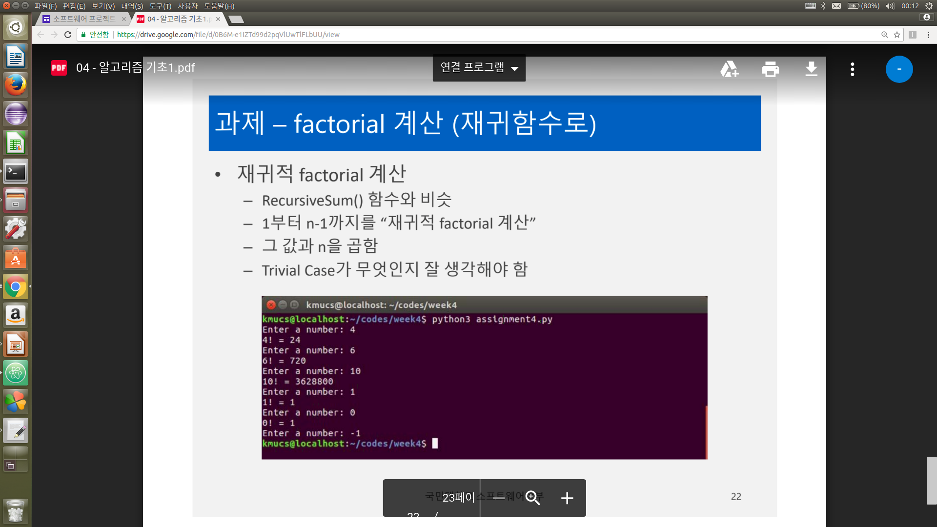
1. Problem
Notes:
<숫자>

Slide 4
2. Solution(before)
# 재귀함수를 이용한 코드
def fac(n):
if n == 1 or n == 0 :
return 1
else :
return n*fac(n-1)
a = input('Enter a number : ')
list = ['1','2','3','4','5','6','7','8','9','0','.','-']
def check_str(k):
p = True
for i in range(len(k)):
if not(k[i] in list) :
p = False
break
return p
while True :
if check_str(a) == False :
a = input('Enter a number : ')
elif float(a) != int(float(a)):
print('잘못입력했습니다!')
a = input('Enter a number : ')
elif int(a) <= -1 :
break
else :
a = int(a)
print(str(a)+'! = ' + str(fac(a)))
a = input('Enter a number : ')

Slide 5
Solutions(after)
def fac(n):
if n == 1 or n == 0 :
return 1
else :
return n*fac(n-1)
a = input('Enter a number : ')
while True :
try :
int(a)
if int(a) <= -1 :
break
else :
a = int(a)
print(str(a)+'! = ' + str(fac(a)))
a = input('Enter a number : ')
except:
print('invaild value')
a = input('Enter a number : ')
Try-except를 써서 더 간결하게 예외처리를 함.!!

